Slide 1
Artificial Neural Networks
اَعُوذُ بِاللہِ مِنَ الشَّیِطٰنِ الرَّجِیمْ
بِسْمِ اللہِ الرَّحَمٰنِ الرَّحِیمْ
Note: Some slides and/or pictures are adapted from Lecture slides / Books of
https://www.coursera.org/specializations/deep-learning
https://d2l.ai/chapter_preface/index.html
https://deeplearning.cs.cmu.edu/S23/index.html

Slide 2
Setting up your ML application
Train/dev/test
sets

Slide 3

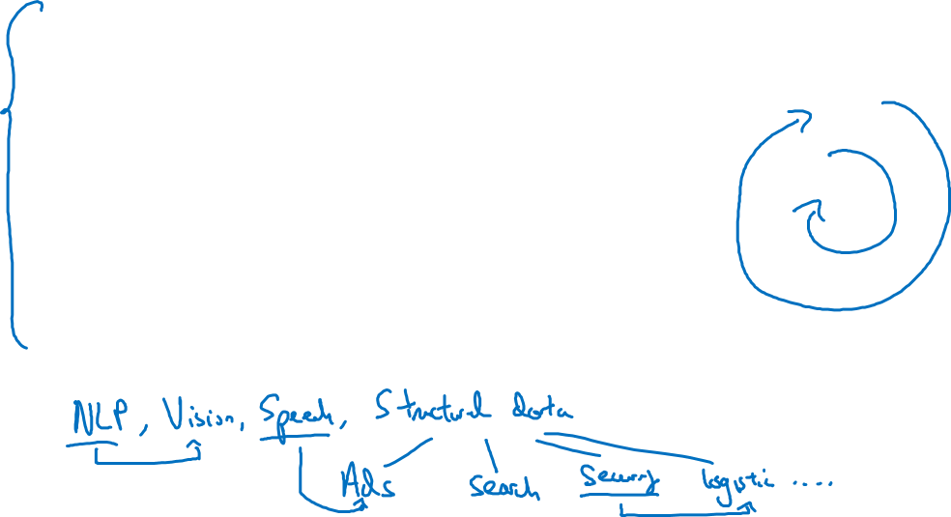
Applied ML is a highly iterative process
# layers
Idea
# hidden units
learning rates
activation functions
…
Experiment
Code

Slide 4
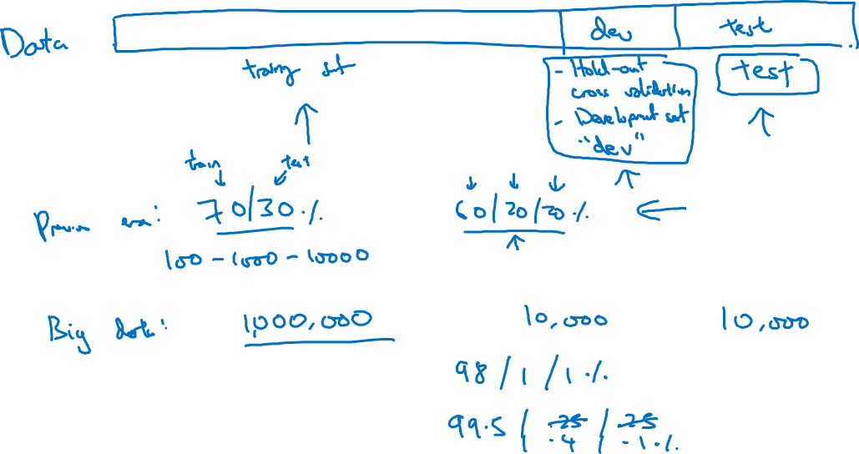
Train/dev/test sets

Slide 5
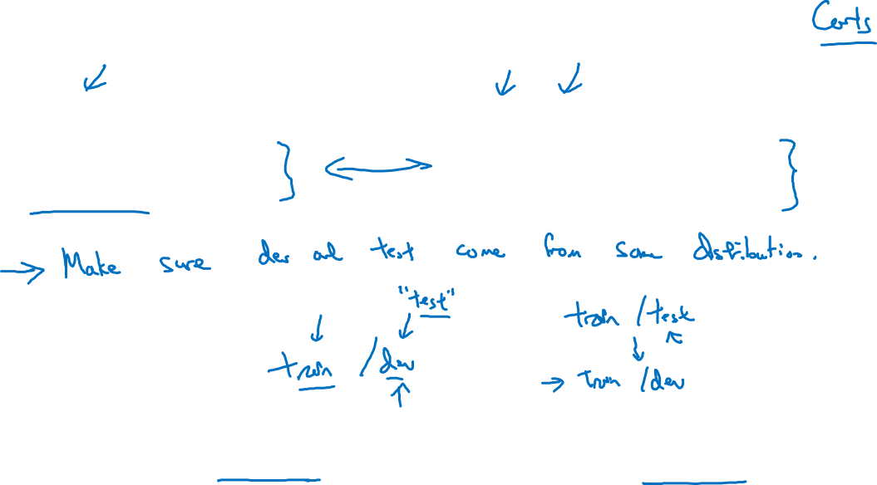
Mismatched train/test distribution
Training set:
Cat pictures from webpages
Dev/test sets:
Cat pictures from users using your app
Not having a test set might be okay. (Only dev set.)

Slide 6
Setting up your ML application
Bias/Variance

Slide 7
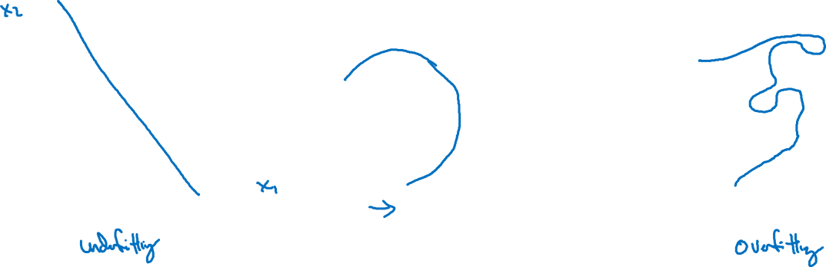
Bias and Variance
high bias
“just right”
high variance

Slide 8

Bias and Variance
Cat classification
Train set error:
Dev set error:

Slide 9
Setting up your ML application
Basic “recipe”
for Machine Learning/ Deep Learning

Slide 10
Basic recipe for machine learning

Slide 11
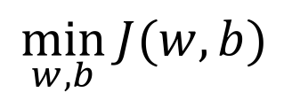
Logistic regression
$$\min_{w,b}{J(w,b)}$$

Slide 12
Neural network

Slide 13
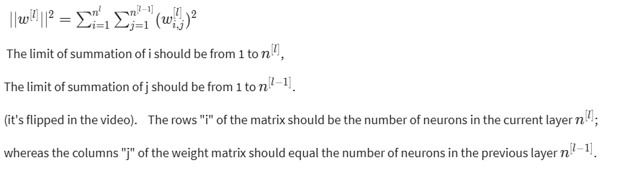
Neural network (correction in previous slide)

Slide 14
Regularizing your neural network
Why regularization reduces overfitting

Slide 15
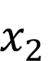
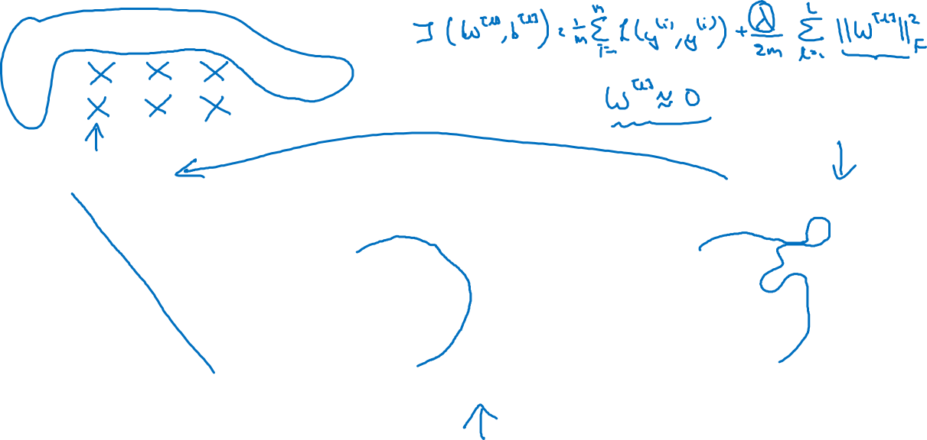
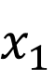
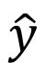
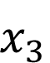
How does regularization prevent overfitting?
$$x_{1}$$
$$x_{2}$$
$$\hat{y}$$
$$x_{3}$$
high bias
“just right”
high variance

Slide 16
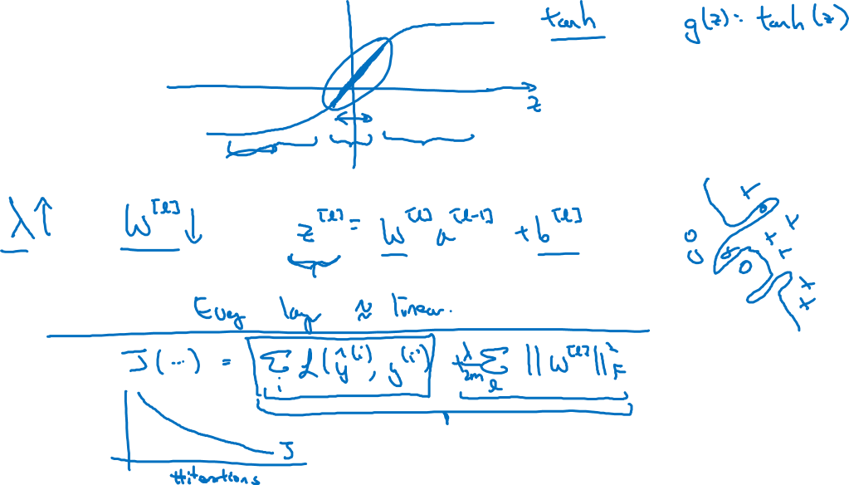
How does regularization prevent overfitting?

Slide 17
Regularizing your neural network
Dropout
regularization

Slide 18
Dropout regularization
$$x_{1}$$
$$x_{1}$$
$$x_{2}$$
$$x_{2}$$
$$\hat{y}$$
$$\hat{y}$$
$$x_{3}$$
$$x_{3}$$
$$x_{4}$$
$$x_{4}$$

Slide 19
Implementing dropout (“Inverted dropout”)

Slide 20
Making predictions at test time

Slide 21
Regularizing your neural network
Understanding
dropout

Slide 22
Why does drop-out work?
Intuition: Can’t rely on any one feature, so have to
spread out weights.
$$x_{1}$$
$$x_{2}$$
$$\hat{y}$$
$$x_{3}$$

Slide 23
Regularizing your neural network
Other regularization
methods

Slide 24





Data augmentation
4

Slide 25
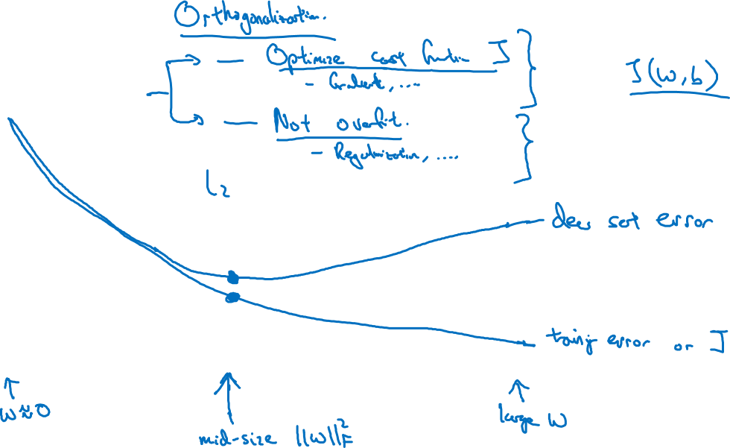
Early stopping
# iterations

Slide 26
Setting up your optimization problem
Normalizing inputs

Slide 27
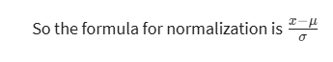
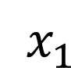
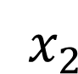
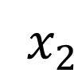
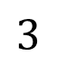
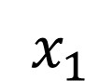
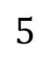
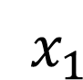
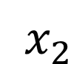
Normalizing training sets
$x_{2}$
$x_{2}$
$$3$$
$x_{2}$
$x_{1}$
$x_{1}$
$x_{1}$
$$5$$
Notes:
Correction: (Subtract the mean and divide by standard deviation)

Slide 28
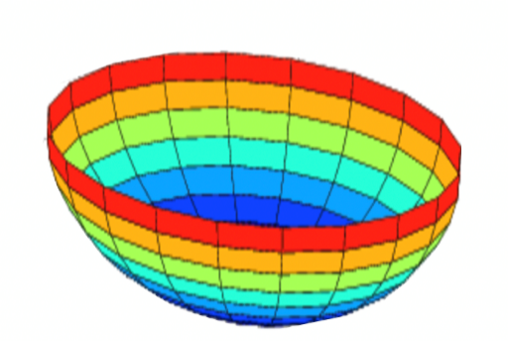
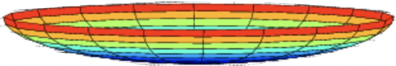

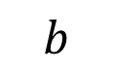
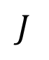
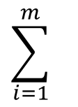
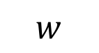
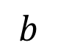
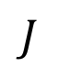
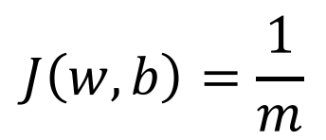
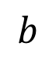
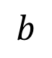
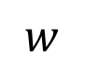
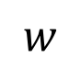
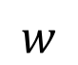
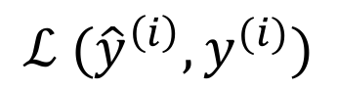
Why normalize inputs?
$$J\left(w,b\right)=\frac{1}{m}$$
$$\sum_{i=1}^{m}{ }$$
$$ℒ ({\hat{y}}^{\left(i\right)},y^{(i)})$$
Unnormalized:
Normalized:
$$J$$
$$J$$
$$w$$
$$w$$
$$b$$
$$b$$
$$b$$
$$b$$
$$w$$
$$w$$

Slide 29
Setting up your optimization problem
Vanishing/exploding
gradients

Slide 30
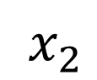
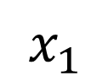
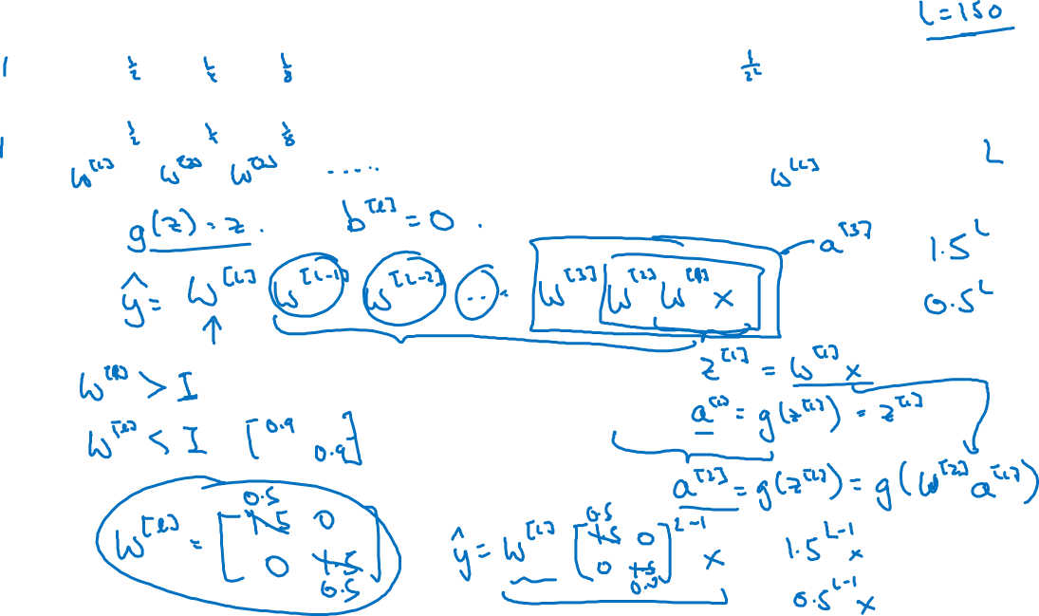
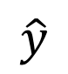
Vanishing/exploding gradients
$x_{1}$
$$\hat{y}$$
$x_{2}$
=

Slide 31
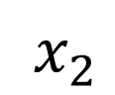
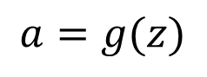
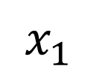
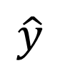
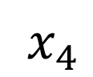
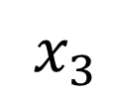
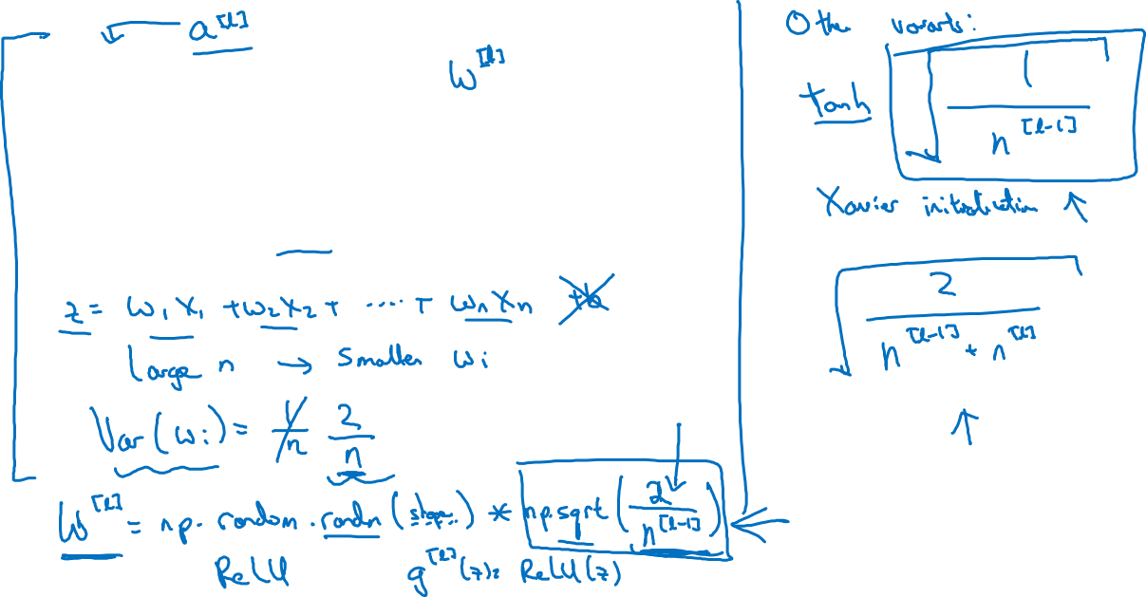
Single neuron example for initialization
$x_{1}$
$x_{2}$
$$\hat{y}$$
$x_{3}$
$x_{4}$
$$a=g(z)$$

Slide 32
Setting up your optimization problem
Numerical approximation
of gradients

Slide 33
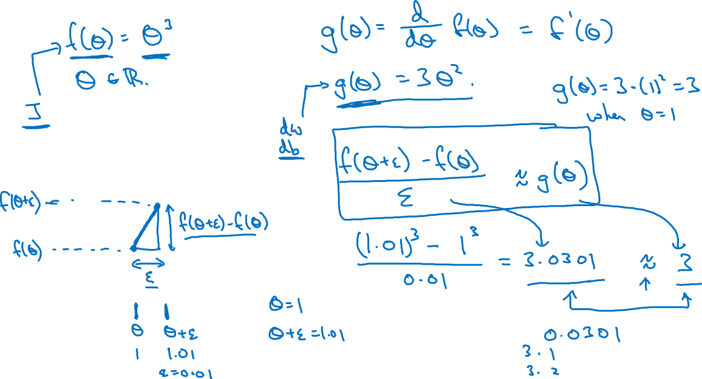
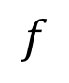
Checking your derivative computation
$$f$$

Slide 34


Checking your derivative computation
$$f$$

Slide 35
Setting up your optimization problem
Gradient Checking

Slide 36

Gradient check for a neural network
Take $W^{\left[1\right]},b^{[1]},…,W^{\left[L\right]},b^{\left[L\right]}$ and reshape into a big vector $θ.$
Take ${dW}^{\left[1\right]},{db}^{[1]},…,{dW}^{\left[L\right]},{db}^{\left[L\right]}$ and reshape into a big vector $dθ.$

Slide 37

Gradient checking (Grad check)

Slide 38
Setting up your optimization problem
Gradient Checking
implementation notes

Slide 39


Gradient checking implementation notes
- Don’t use in training – only to debug
- If algorithm fails grad check, look at components to try to identify bug.
- Remember regularization.
- Doesn’t work with dropout.
- Run at random initialization; perhaps again after some training.

Slide 40
Q & A

